Slide 1



Your Mental
Wellbeing Partner

Slide 2







We Help with Life’s Troubling Issues
Stress, anxiety, panic
Depression
Difficult relationships
Sleep
Substance Use

Slide 3







Real Help for the Everyday
Challenges that Worry You
Struggles at Work
Overwhelmed/Too Much To Do
Family or Parenting
Financial Stress
Legal Questions

Slide 4




Free and Confidential Services —
For Everyone!
Employees
Spouses or Domestic Partners
Dependents up to Age 26
No Enrollment Necessary

Slide 5




Short Term Solution-Focused Counseling
Resolves Real-Life Issues
v
v
v
Up to 5 sessions
per person per problem type
12-month period
Individuals, Couples, Family, Teens
Quick, convenient connection,
multiple options
In-person, video,
telephone, live
chat, text
Notes:
Counseling
Short term solution focused care, remind employees that there are different buckets available for each person enrolled (spouse/domestic partner, dependents up to age 26), approximately 90% are using phone or video (most therapists will steer away from chat or texting). Reduce the stigma and making it feel normal - we've all had problems where we have been worried or tense: give examples.

Slide 6



Counseling Options
that Work with Busy Lives
v
v
In-person
counseling
Online counseling with BetterHelp
A more traditional
face-to-face experience
Convenient video,
chat, telephone, and
text options

Slide 7


Counselor Connect Concierge Service
for Ease of Access
High touch white glove service, available
to all members
Access Center does all the legwork
Collects detailed member preferences
Identifies counselors who best match preferences & have availability/capacity to take on new clients
Provides member with counselor contact information
Follows up to ensure member has successfully
connected with a counselor
Notes:
Virtual and In-Person appointments
Counselors from Concern Provider Network
Includes help with first responder counselors
AC follows up with member within two days to confirm connection
between member & counselor
Client confirms appointment made – or …
If appointment not made, AC offers to help them locate another counselor who meets their needs

Slide 8






Overwhelmed, In Distress
or Just Want to Talk?
800.344.4222 for
in-the-moment support
Unlimited 24/7 access to mental health professionals
Find a positive way forward
Connect to ongoing support

Slide 9



More Care Options for Learning
New Skills & Changing Habits
v
v
v
Effective 1/1/2025 Personal coaching
Parent
coaching
Guided Mindfulness with eM Life
Strategic approach
to stress, sleep,
personal health,
and achieving goals.
Personalized guidance
to overcome parenting challenges and
find solutions
Develop skills to
improve mental and
physical wellbeing

Slide 10

Personal Coaching to Achieve Goals
Four, 30-minute telephone sessions
with an experienced, certified coach
to learn new skills
Personal growth: Reduce stress,
improve sleep, weight management,
healthier habits
Professional growth: Work-life
balance, manage burnout, improve
time management and mental fitness
Notes:
Improve overall wellbeing
Work on challenges like:
Stress
Sleep
Work-Life Balance
Experienced, certified coaches
Four, 30-minute telephone sessions
National Board for Health and Wellness Coaching NBHC certified, URAC accredited
Positive choice – no stigma, great way to start getting support – proven results
Motivational interviewing – positive, nonjudgmental
Four 30- minute sessions/contract year
Oriented to Concern - Oriented to Concern solutions. Will refer to Concern’s resources and to counseling. Coaches will know if a client needs to be referred to counseling.
Easy access, online scheduling –Coaches partner with clients seeking to enhance their wellbeing through self-directed, lasting changes
Coaches help individual set priorities, clarify values, talk through challenges and create their own plan for wellbeing
New skills that can be applied to any new goal/topic
Gain access from Concern call center or via digital platform – will link to coaching partner
After answering 3 security questions and entering time zone – given access to a calendar to schedule their own sessions - they can have the same coach for all four sessions
Difference between coaching & counseling
Coaches guide by asking questions and structuring a process for individuals to achieve their physical and emotional wellbeing goals
Counselors focus on mental health and emotional healing for issues like anxiety and depression, which impair the ability to function well
All coaches have a bachelor’s degree or higher
Every coach has earned a health & wellness coaching certification through the
National Board of Health & Wellness Coaching (NBHWC)
Coaches are not mental health professionals. I think of coaching in terms of sports or music. Talking to a coach is easy! Coaches are someone in your court who can help you improve on or gain a new skill or habit.
In addition to counseling, you/one/everyone (minimum age is 18) has up to 4 sessions a year to work with a coach on any emotional, physical, or professional goal!
For example, you may want to improve your communication or delegation, maybe your leader pointed out some of these areas for improvement that could help you grow in your role/grow in the org – this is a great proactive step to work on building/improving those skills!
Maybe you want to reduce stress. You do not necessarily need to talk to a counselor but talking to someone in your court who can help you achieve SMART goals is helpful.
You do not have to work on the same topic for all 4 sessions!

Slide 11

Parent Coaching
to Enrich Relationships
Three telephone sessions with an
experienced coach emphasizing
proactive vs. reactive parenting
Positive, nonjudgmental approach
suitable for children of all ages
Better understand and address challenges
with child development & behavior,
pre-teen issues, screen time, social
anxiety and cyberbullying
Notes:
Sometimes parents need help with their children’s emotional wellbeing and may not know where to start. Parent coaching is a great first step! You can talk to a licensed professional.
An example of when an individual can reach out is when parents are challenged with children growing into adolescence, excessive screen time or gaming (which was huge during COVID), social anxiety, and cyber bullying. These are topics we might not have had to deal with growing up and is even more present with our children nowadays. Parents can connect and learn tools to help with being a proactive parent vs. reactive.
There are 3 free sessions: Initial 60-minute call and two 30-minute follow-up calls
Parenting counseling can work in conjunction with counseling services and both parents can utilize the service at the same time
Some examples of when this could be utilized is when
These are experienced parent coaches that will help parents understand the issues, guide them in making decisions,
and provide them with the tools to create healthier, more fulfilling relationships with their children
Learn practical strategies and solutions for common challenges
Example topics:
Child development & behavior
Early parenting
Mental health & kids
Sibling rivalry
Pre-teen issues
Highschool challenges
Social anxiety
Excessive screen time
And more...

Slide 12


Guided Mindfulness with
Easy to use on-demand and live programs help build sustainable life-changing skills that improve mental and physical wellbeing
    Meditative breathing practices, awareness,
    being present
    Kindness, compassion, gratitude
    Stress, sleep, burnout
    Relationships, grief, loss
    Chronic pain, weight loss, diabetes, smoking cessation
Notes:
We partnered with eMindful, who is a leading provider of evidence-based mindfulness solution (March 2021).
Mindfulness can be used for things we all deal with for example concerns about weight loss, lack of sleep, stress, smoking cessation, burnout; chronic conditions, including diabetes.
Some of these programs are just 14 minutes in length.
There are hundreds of hours of quick on-demand content
There are also live, expert-led daily mindful sessions that are delivered multiple times throughout the day
Example ** We had feedback from a first responder that when he would get off of his shift, go into a spare bedroom and listen to a mindfulness session to reduce stress, just so he could deal with his family and not take the stress from work to his interactions with his family.
Helps us manage emotions, new perspective around stressful situations.
Covers breadth of behavioral health options
Fully integrated into Concern’s digital platform
Truly personalized experience to right mindfulness solution
Skill building drives sustainable, life-changing results
Hundreds of hours of quick, easy-to-use on-demand content
Live, expert-led daily mindful sessions delivered multiple times each day

Slide 13






Work-Life Solutions
Expert guidance for peace of mind
Financial consultations
Legal consultations
Identity theft response and prevention resources
Childcare and Adult care referrals and resources
Notes:
Financial
Being more financially literate
Are you worried about monthly expenses (credit card debt)?
Legal
Get ahead of the worry and plan for the unplanned by implementing a will or trust. Get a second opinion with an expert. Refer to family law versus divorce or custody.
ID Theft Response A service that we hope you don’t need but available should you need it. Free ID theft kit, consultant will walk you through the process. Help you prevent future ID theft and helps you rebuild your credit.
Childcare Referrals
Qualified childcare who has openings (check with KGA). Vetted Professionals. Specific features of what the family is calling for (a few that meet your needs) Provide rates of services/registration fees, how many children are in the center.
Emergency childcare
Eldercare
Packages and information around having your family members stay in their own home and get the services they need (food, in home caregiver, transportation to and from medical services).

Slide 14
Help for Things That Keep You Up at Night
v
v
v
Financial Consultations
Legal Consultations
Identity Theft
Up to two 30-minute
sessions per topic per
year. Help with debt, budgeting, credit,
taxes, and more.
One 30-minute consultation with an attorney per legal
issue per year. Help with
estate planning, family, personal injury, and more.
25% discount off
standard rates when
you retain services.
One 60-minute consultation with a fraud resolution specialist. Help dispute fraudulent debt, communicate with
creditors, and restore identity and credit.
Notes:
Financial consultations
One or two 30-minute sessions per topic area per year with a certified financial specialist
Being more financially literate
Are you worried about monthly expenses (credit card debt)?
These are licensed professionals that are not there to sell you anything their goal is to help the individual with whatever financial challenge they face.
Legal Consultations
Our network of practicing attorneys must have a minimum of five years of legal practice experience,
hold a current license and be a member in good standing in their state bar association. You can receive up to 30 minutes with an attorney per topic area per year. This can be done over the phone or in person. If you happen to adopt the services of that attorney, you will receive a 25% reduction from their normal hourly rate.
Since attorneys can be costly a discount is a benefit worth taking. We have a Network throughout the US. Some of the issues they can assist with are:
• Family: Marital, child custody, child support, adoption
• Civil: Patents, trademarks, traffic violations, accidents, repossessions, collections, contractual disputes, defaults and foreclosures• Estate: Estate planning and probate• Landlord/Tenant• Immigration• Personal Injury• Consumer and Consumer Protection• Financial• Business• Felony Cases• Real Estate• Bankruptcy
Due to conflict of interest, we cannot offer legal advice against any employer or health plan.
Identity Theft
I hate to say this but, Identity Theft is unfortunately becoming more common of an issue and individuals need to take the steps to prepare should they be faced with this or to repair their credit and identity.
Employees can receive a free 60-minute consultation with a fraud resolution specialist along with an Identity theft response Kit
You can receive tips with disputing fraudulent activity and communicating with creditors
This benefit can be utilized even if you have not been a victim of identity theft it can be accessed for preventative measures as well.

Slide 15


Caring for Those Who Depend on You Most
v
v
Parenting & Childcare
Adult Family Care
Referrals for daycare, after-school
care, tutors, mentors, enrichment
programs, adoption services,
and programs for children
with special needs
Free New Baby kit
Answers to questions on Social Security
and Medicare and referrals for transportation, assisted living,
home health, and community
support services
Free How to Care for Aging
Parents book
Notes:
Parenting and childcare referrals
This resource is not as highly utilized as others since most parents tend to get on Google and search on their own. However, if you’re like most and don’t have a lot of time and would like for someone to provided vetted professionals this is a great starting point. Concern can help with:
Childcare resources and referrals/Family day care, childcare center, nanny/Adoption services/Local and National organizations//Programs for children with special needs/Support and advocacy, in-home caregivers/Academic services
Public and private schools, before and after school programs, college search, and financial aid/Services for at-risk or high-risk adolescents/Summer care options/Sports, academic and fine arts programs/Tutors, mentors, and enrichment programs
Expecting parents can call or request a complimentary New baby kit online – They receive a book “What to expect the first year” and a onesie with the Concern logo on it.
Streaming video “Happiest Baby on the Block” (in English/Spanish)
Download of “Super Soothing Sleep Sounds”
Eldercare
If you have an aging family member or any other family member that causes concern for their wellbeing you can utilize the services available through adult care consultations. You’ll receive confidential
support and follow up at week one, week three, and at six months. For things like:
Transportation Services to and from medical appointments
They can even guide you on communication ideas in dealing with a difficult conversation * example talking to parent about moving into a assisted living program
Medicare and state-specific program education
Assisted living, residential, skilled nursing and adult daycare options
Meals on Wheels
Community support groups
Home health services options
Adult care attorneys
You can also receive a free book with the first call - * How to Care for Aging Parents

Slide 16


Review Your Benefit Summary
for Full Details
  Two easy ways to access
Call Concern:
800.344.4222
(Call to request counseling for anyone under the age of 18)
Visit:
employees.concernhealth.com
Enter company code – SETA
and click on “Get Services”

Slide 17





Our Digital Hub Gives Access
to All Concern Services
One-stop shop
Easy way to get started
Personalized care options
and recommendations
Visit employees.concernhealth.com and click Get Services
Notes:
Can review all services mentioned in the presentation
View providers by
Their specialties
What languages they speak
Gender
If they are contracted with your medical plan.
Read their bios

Slide 18

Supporting
Organizational Excellence

Slide 19
Expert Support and Guidance for Complex Organizational Situations
Management Consultations for HR professionals and leaders
Formal Referrals for performance or behavioral problems
Timely Critical Incident Response with highly skilled providers
Organizational Consulting* for handling conflict, team cohesion, and leadership development. *Additional charges may apply.

Slide 20




Unlimited Access to Clinical Managers for Tough Employee Issues
Psychiatric Emergencies
Performance or
Behavioral Problems
Suspected Substance Use
Crisis Support

Slide 21





Critical Incident Response (CIR) Services Help Organizations and Employees Cope
Death of a
colleague
Serious accident
or injury
Witness
traumatic event
Natural or
man-made disaster
Volatile workplace situation

Slide 22




CIR Team Mobilized Rapidly
Collaborative determination of timing and response
Network of Trained Critical Incident Counselors
In-person Counseling Support
Debrief and/or Psychological First Aid

Slide 23


Promote Awareness and Wellbeing
Engaging, Live Webinars
Expert Trainers Teach Health and Wellness, Stress and Resilience, Communication and More
3 Annual Hours for Training and Crisis Support
Schedule Early and Promote
Often to Engage Employees
Notes:
Please keep in mind we will do our best to accommodate last minute changes, but our speakers get booked very quickly, so that when you do want to schedule a webinar training, please check your company calendars to ensure that you don’t have any conflicts. Last minute changes and/or cancellation will be charged to your bank of hours or billed to the group is that bank has been exhausted.

Slide 24
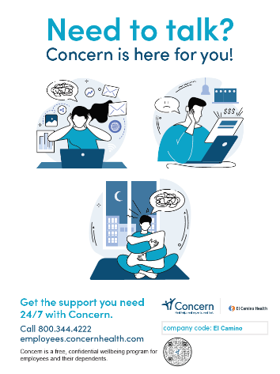
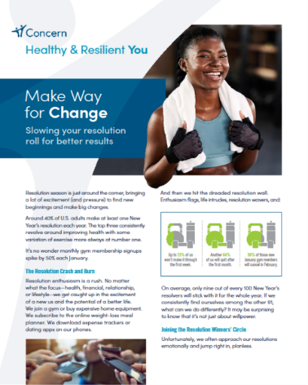
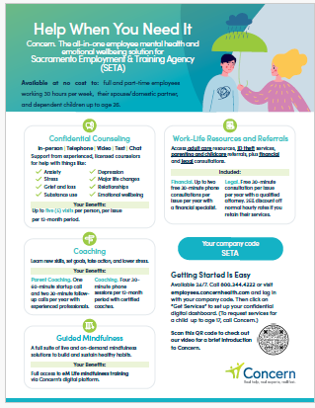

Easily Download Fun, Engaging, Promotional Materials

Slide 25
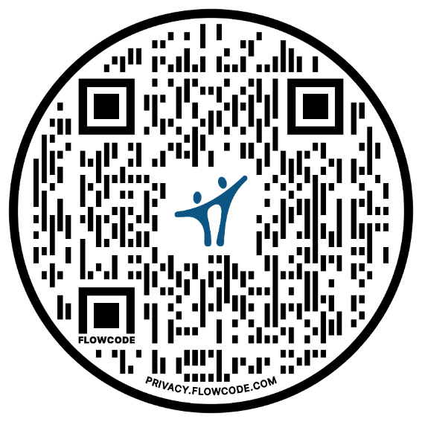
Where to Begin
SCAN ME!
  Reach out to your Accouunt Executive: Minnie Kyotani at 408-406-1260 or Minnie_Kyotani@concernhealth.com
  Review the Benefit Summary Flyer
  Watch the About Concern Video for
  a short introduction
  Access 24/7
    Visit employees.concernhealth.com. Enter company code: SETA and Click, ‘Get Started’
    Call 800-344-4222

